Slide 1
Microservices
API

Slide 2
What are Microservices?
It is an architectural style that structures an application as a collection of services that are
Highly maintainable and testable
Loosely coupled
Independently deployable
Organized around business capabilities
Advantage:
The microservice architecture enables the rapid, frequent and reliable delivery of large, complex application as a collection of small autonomous services, modeled around a business domain.

Slide 3

Monolithic
Architecture
Microservices
Architecture
UI
UI
Business
Logic
DAL
Microservice
Microservice
Microservice
Microservice
DATABASE
DATABASE
DATABASE
DATABASE

Slide 4
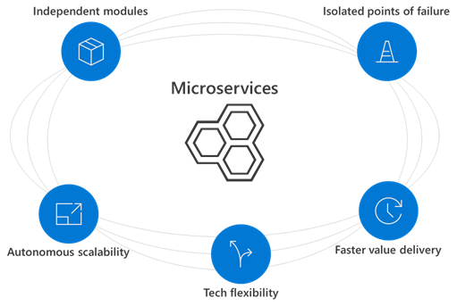

Slide 5
Some important facts about MICROSERVICES
Microservices are smaller in size
Microservices are easier to develop, deploy, and debug, because a fix only needs to be deployed onto the microservice with the bug, instead of across the board
Microservices can be scaled quickly and can be reused among different projects
Microservices work well with containers like Docker
Microservices are independent of each other, meaning that if one of the microservices goes down, there is little risk of the full application shutting down
Microservices don't need to share the same technology stack, libraries, or frameworks.

Slide 6

Highly observable and independently deployable
CRITERIA FOR CHOOSING A TECHNOLOGY FOR MICROSERVICES
Support automation – CI / CD
Follows Decentralization of components
Modelled around Business Domain
Language and Framework – Python, Java, Dot Net, Node JS
Deployment Model – API, Containerisation
Platform – Azure, AWS, GCP, Docker, Serverless

Slide 7


YOU HAVE TO DECIDE
WHICH LANGUAGE?
WHICH PLATFORM?
WHICH DEVELOPMENT MODEL?
WHICH TOOLS?

Slide 8

JACK is a Developer
Knows C# Dot Net
Knows MVC architecture
Knows Angular
Basics of Cloud computing
API
CONTAINER
IAAS
PAAS
FAAS
IAAS
PAAS
VM
App
Az-Func
Docker
AKS
SF
ACI
API Gateway
API Gateway

Slide 9

There are some “super humans” who try to learn all the possible ways to implement microservices.
Eventually most of them end up doing something like this

Slide 10



API
CONTAINER
LOGIC
LOGIC
Code
+
dep
APP/API
LOGIC
IMAGE
LOGIC
Hosting environment
Docker HOST
IMAGE
VM
App Service
Azure Function
CONTAINER

Slide 11
IMAGE= code + dependencies
CONTAINER = instance of an image

Slide 12

DEMO
Deploying API as a Container
1
2
3
Deploy it to
Azure CR
Develop API in
Visual Studio
Azure App service
based on IMAGE

Slide 13
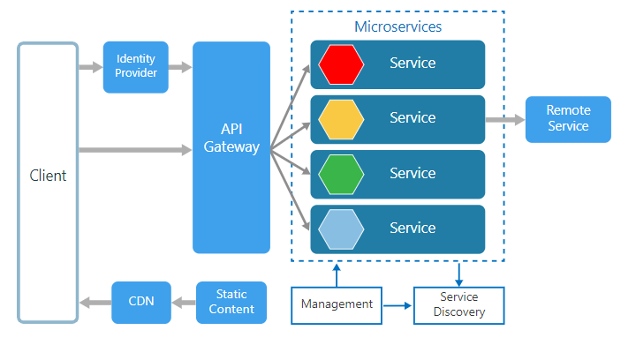
Microservices Detailed architecture

Slide 14
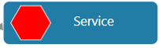
AWS Lamba
Azure function
Service Bus ( Queue )
App service
On prem

Slide 15
IAAS - exp
PAAS – less exp
SAAS – even less exp
FAAS – cheapest way
per second billing
charge for execution time

Slide 16
Microservice
Web deploy
ACR –
API
Powershell
App service with container
App service plan

Slide 17
App/Api
Appservice
image
Appservice
ACR
DH
container
Appservice
Wordpress
image

Slide 18
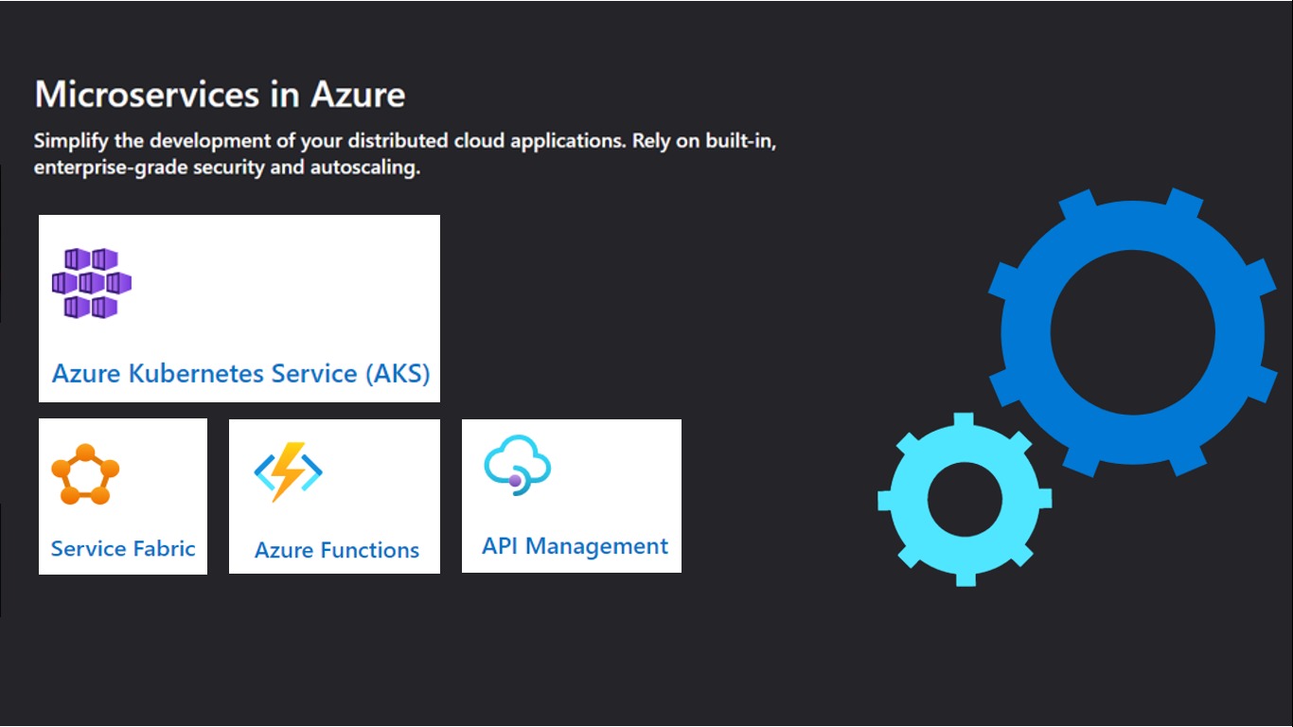

Slide 19
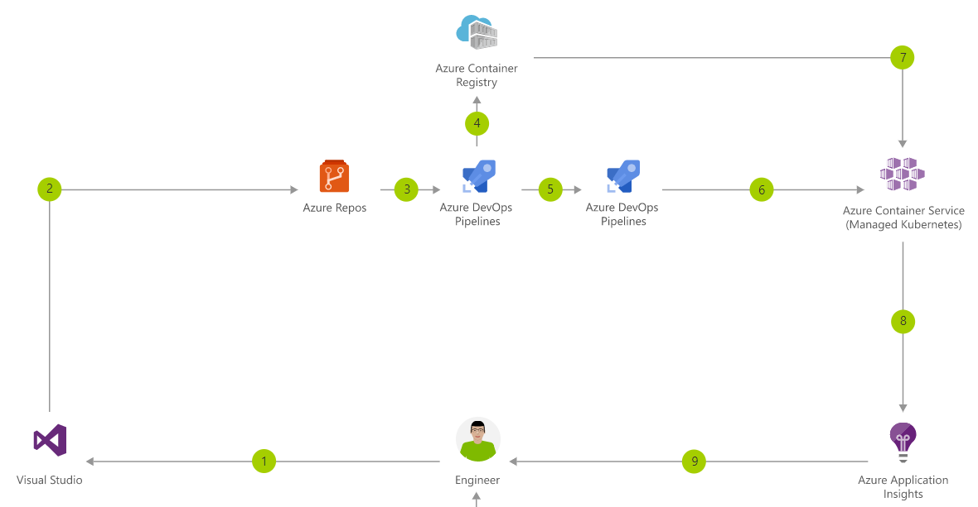

Slide 20
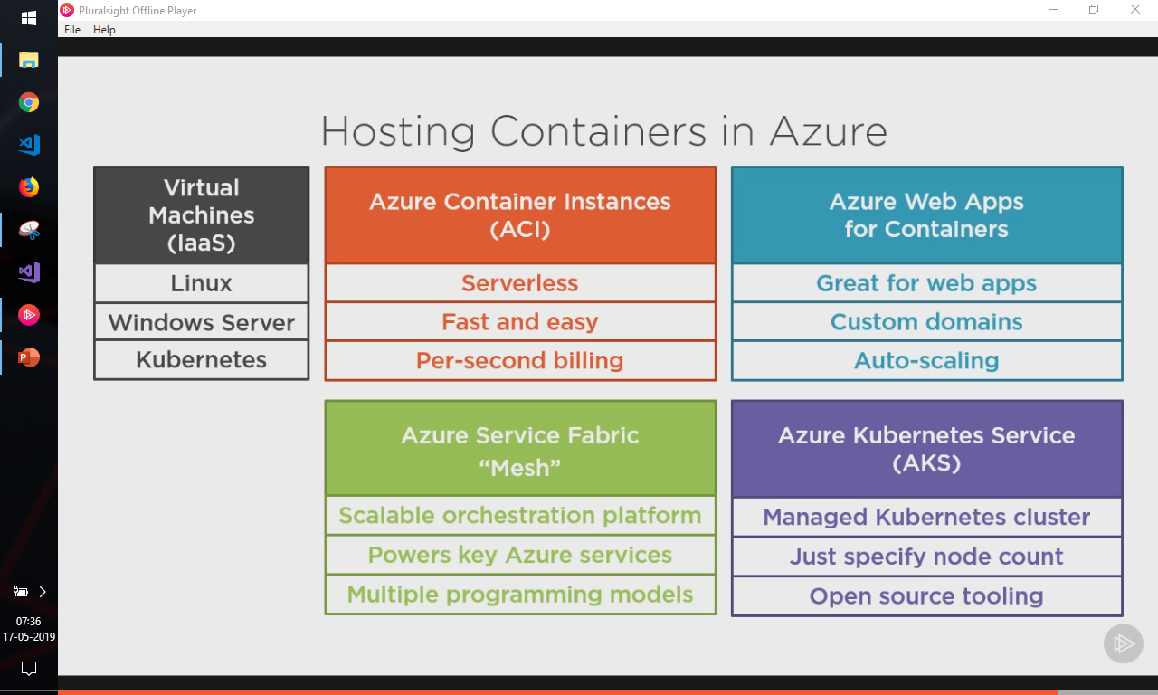

Slide 21
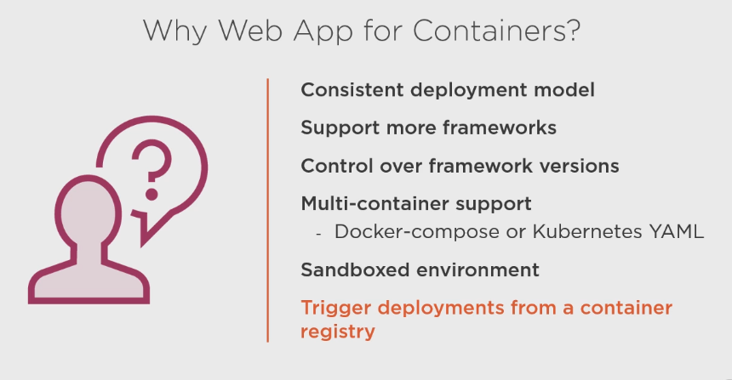

Slide 22
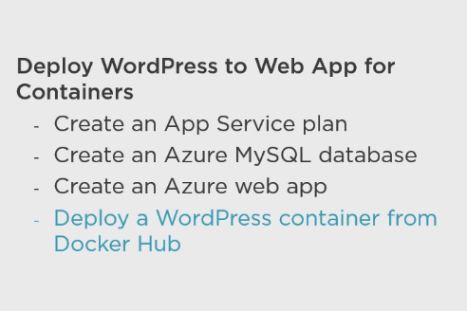

Slide 23
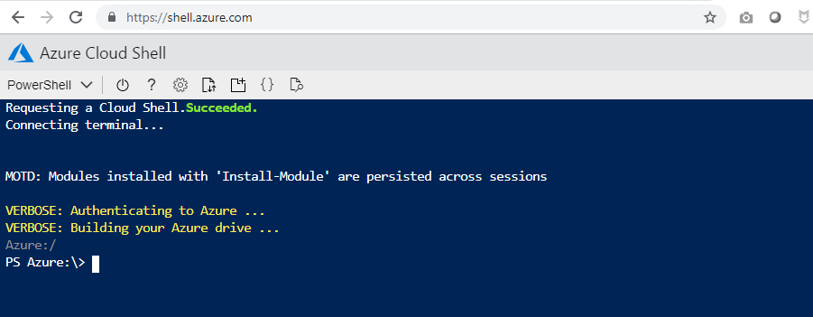

Slide 24
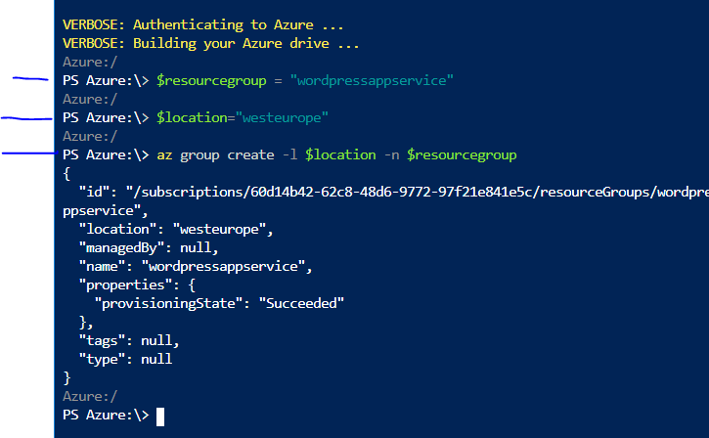

Slide 25
Now lets create app service plan
$planname="wordpressappservice"
We have chosen linux container and
S1 pricing tier

Slide 26
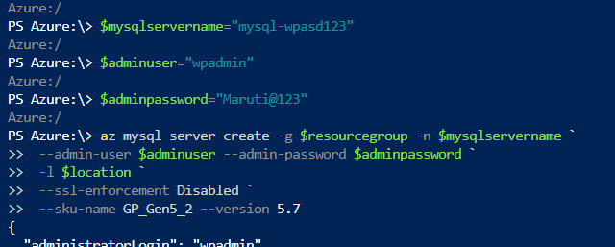
Now lets create MySQL db

Slide 27
$resourcegroup="wordpressappservice"
$location="southeastasia"
az group create -l $location -n $resourcegroup
$planname="wordpressappservice"
az appservice plan create -n $planname -g $resourceGroup `
-l $location --is-linux --sku S1
$mysqlservername="mysql-wpasd123"
$adminuser="wpadmin"
$adminpassword="Maruti@123"
az mysql server create -g $resourcegroup -n $mysqlservername `
--admin-user $adminuser --admin-password $adminpassword `
-l $location `
--ssl-enforcement Disabled `
--sku-name GP_Gen5_2 --version 5.7

Slide 28
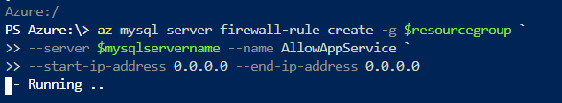
Now lets allow firewall rule for my appservice
To talk to it
This means we are allowing all traffic

Slide 29
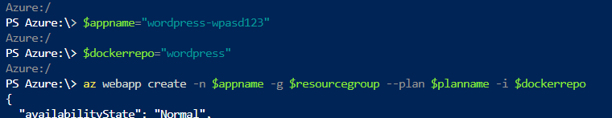
Now let’s create app using docker image

Slide 30
$resourcegroup="wordpressappservice"
$location="southeastasia"
az group create -l $location -n $resourcegroup
$planname="wordpressappservice"
az appservice plan create -n $planname -g $resourceGroup `
-l $location --is-linux --sku S1
$mysqlservername="mysql-wpasd123"
$adminuser="wpadmin"
$adminpassword="Maruti@123"
az mysql server create -g $resourcegroup -n $mysqlservername `
--admin-user $adminuser --admin-password $adminpassword `
-l $location `
--ssl-enforcement Disabled `
--sku-name GP_Gen5_2 --version 5.7
az mysql server firewall-rule create -g $resourcegroup `
--server $mysqlservername --name AllowAppService `
--start-ip-address 0.0.0.0 --end-ip-address 0.0.0.0
$appname="wordpress-wpasd123"
$dockerrepo="wordpress"
az webapp create -n $appname -g $resourcegroup --plan $planname -i $dockerrepo

Slide 31
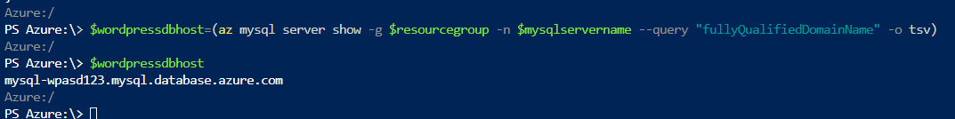
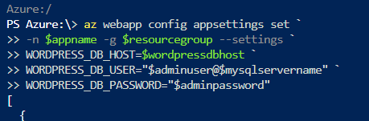
Now we need to connect our app with mysql db
So with configuration params which are required

Slide 32
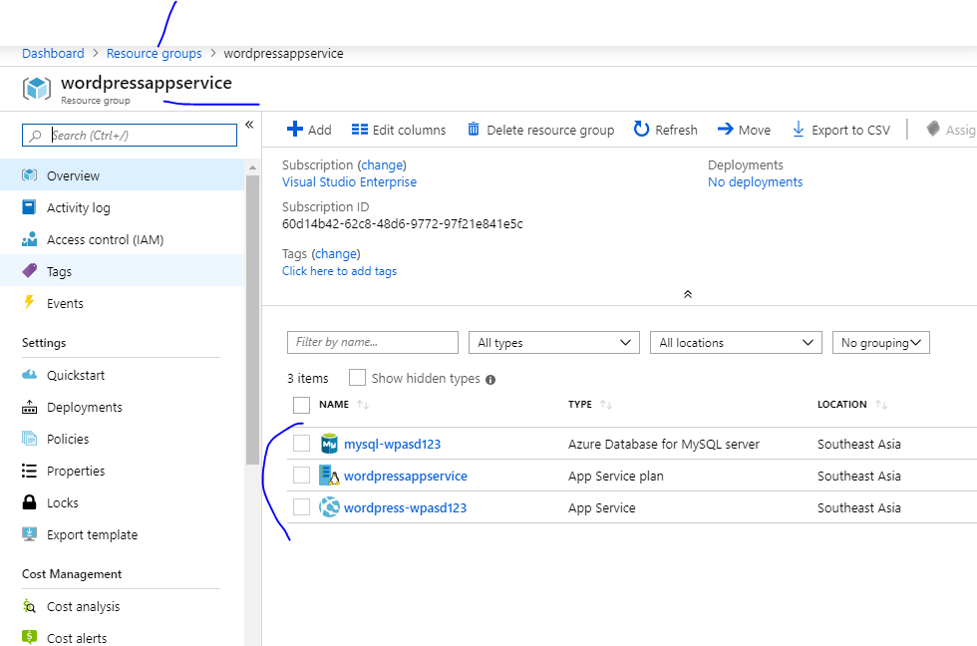

Slide 33
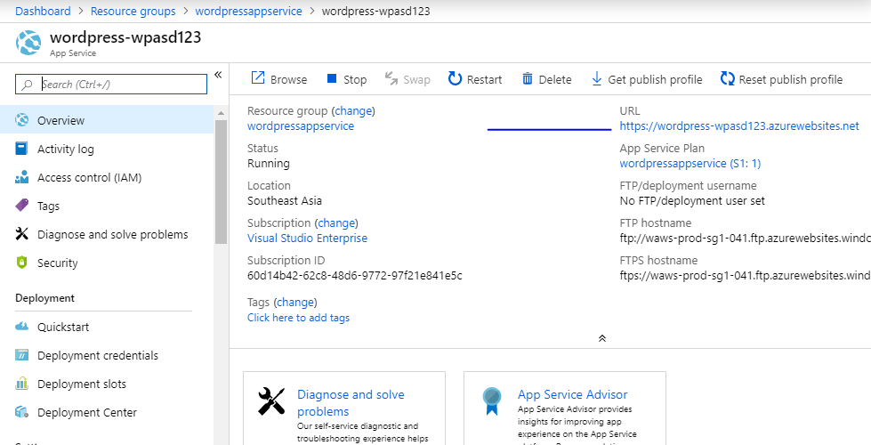

Slide 34
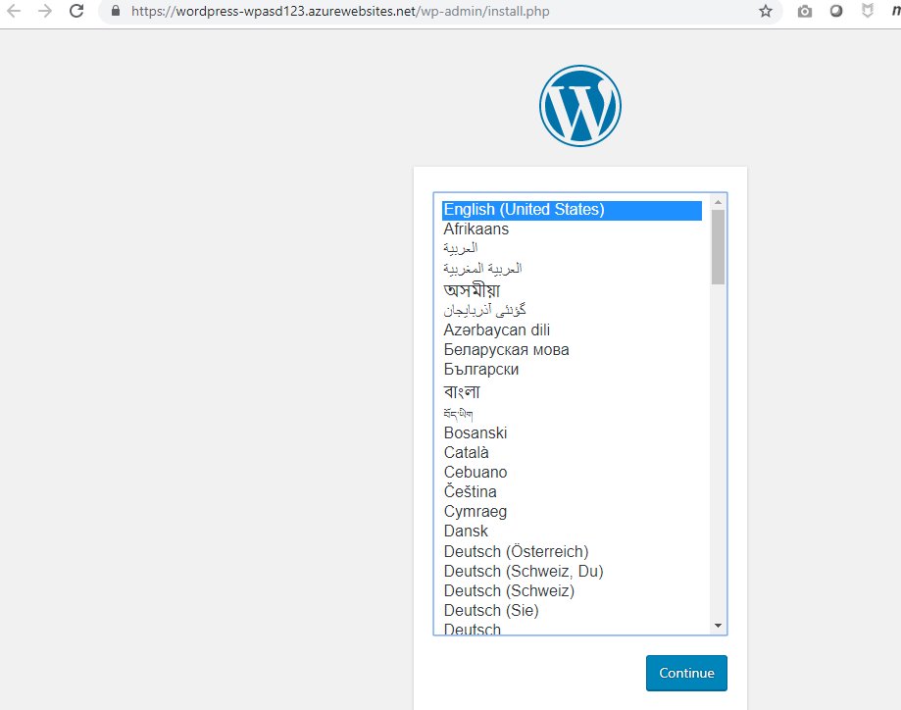

Slide 35
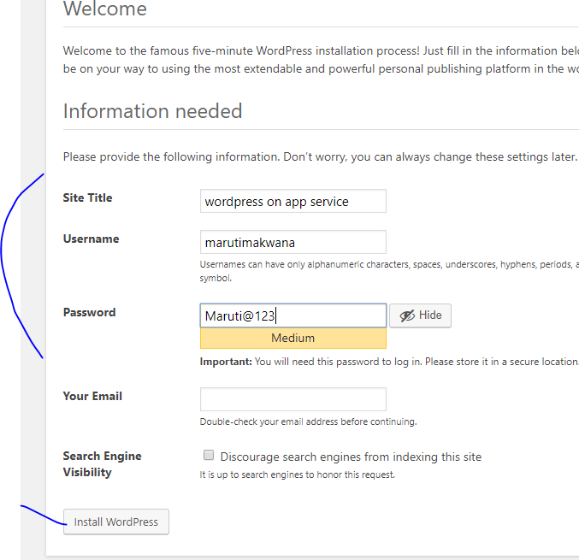

Slide 36
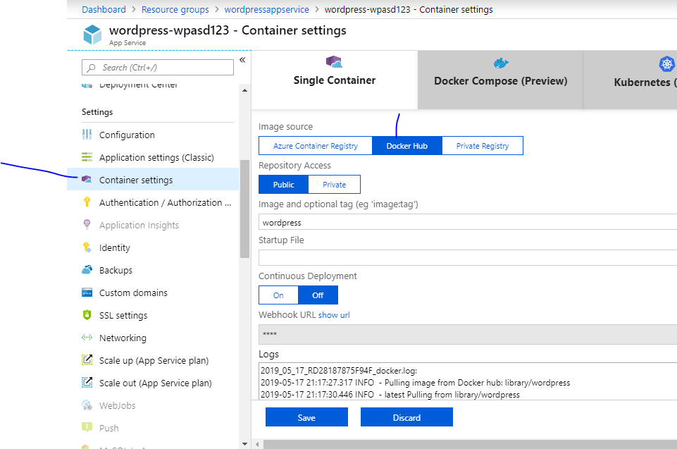

Slide 37
$resourcegroup="wordpressappservice"
$location="southeastasia"
az group create -l $location -n $resourcegroup
$planname="wordpressappservice"
az appservice plan create -n $planname -g $resourceGroup `
-l $location --is-linux --sku S1
$mysqlservername="mysql-wpasd123"
$adminuser="wpadmin"
$adminpassword="Maruti@123"
az mysql server create -g $resourcegroup -n $mysqlservername `
--admin-user $adminuser --admin-password $adminpassword `
-l $location `
--ssl-enforcement Disabled `
--sku-name GP_Gen5_2 --version 5.7
az mysql server firewall-rule create -g $resourcegroup `
--server $mysqlservername --name AllowAppService `
--start-ip-address 0.0.0.0 --end-ip-address 0.0.0.0
$appname="wordpress-wpasd123"
$dockerrepo="wordpress"
az webapp create -n $appname -g $resourcegroup --plan $planname -i $dockerrepo
$wordpressdbhost=(az mysql server show -g $resourcegroup -n $mysqlservername --query "fullyQualifiedDomainName" -o tsv)
$wordpressdbhost
az webapp config appsettings set `
-n $appname -g $resourcegroup --settings `
WORDPRESS_DB_HOST=$wordpressdbhost `
WORDPRESS_DB_USER="$adminuser@$mysqlservername" `
WORDPRESS_DB_PASSWORD="$adminpassword"

Slide 38
If you have multiple API for your project
Then use API Management

Slide 39
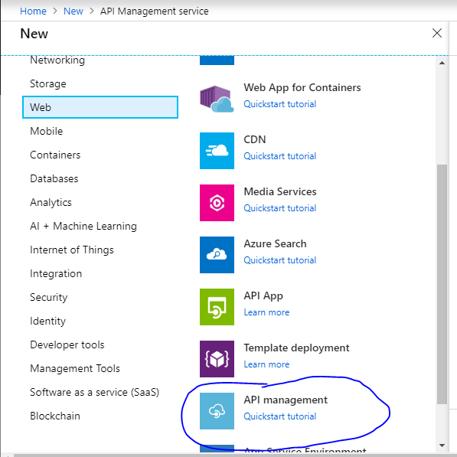

Slide 40
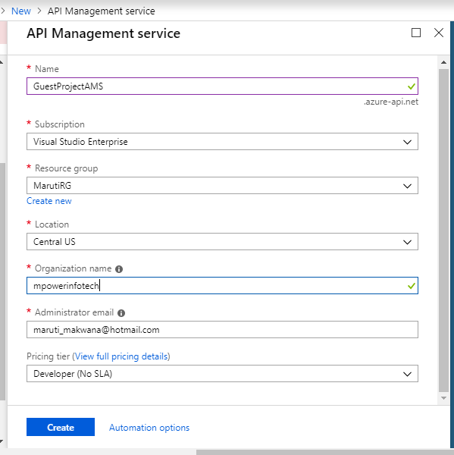
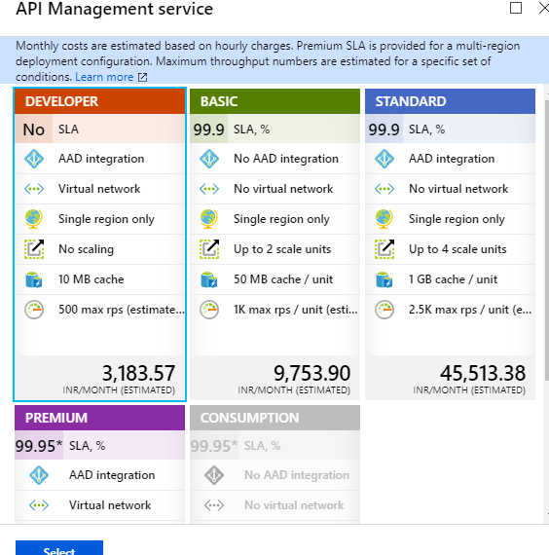

Slide 41
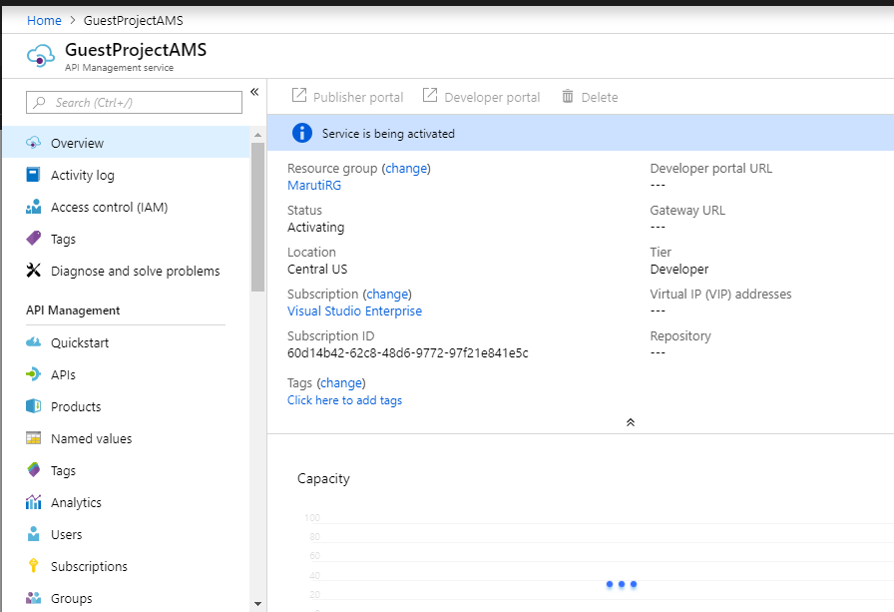
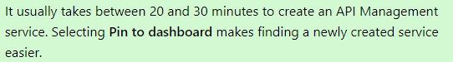

Slide 42
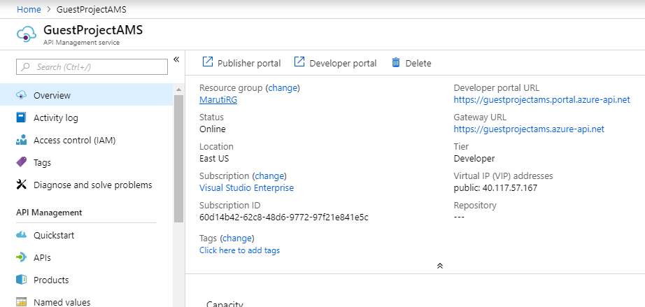

Slide 43
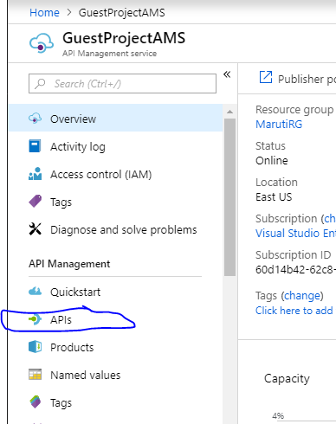

Slide 44
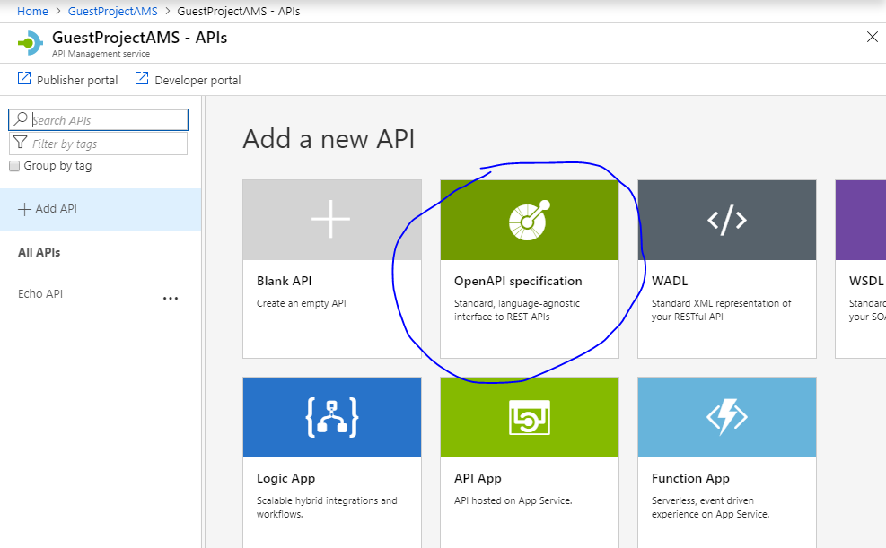

Slide 45
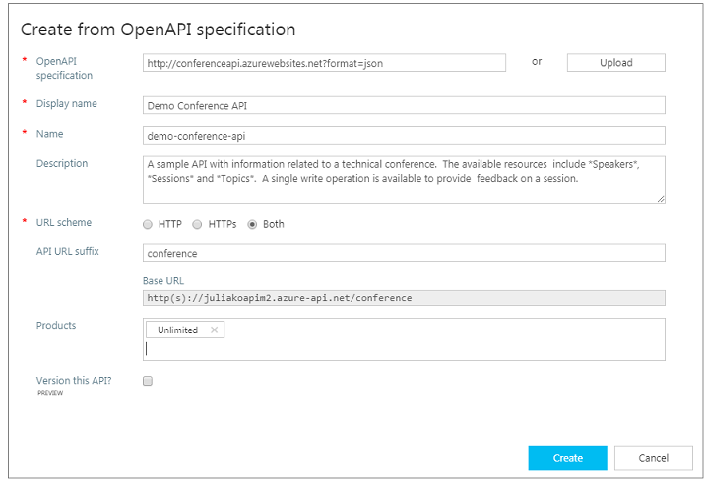

Slide 46
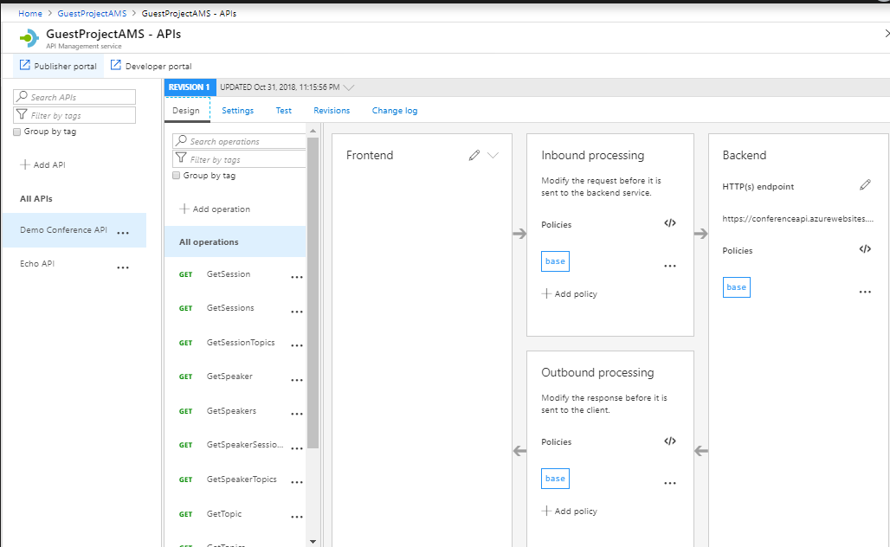

Slide 47
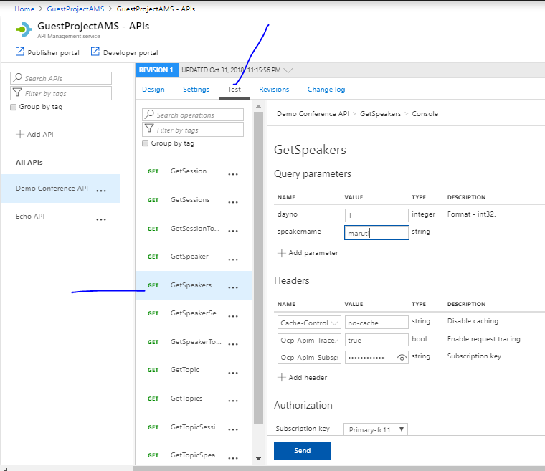

Slide 48
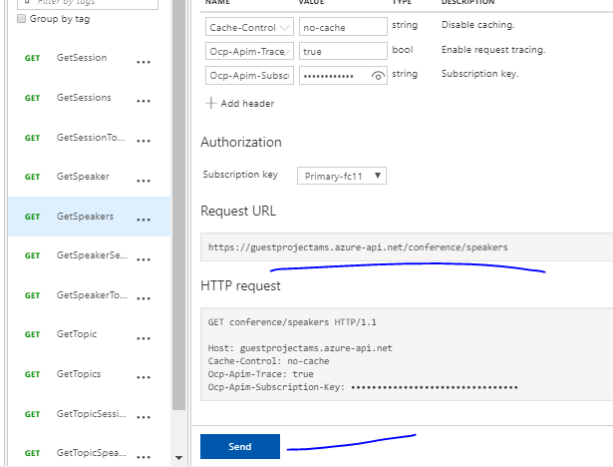

Slide 49
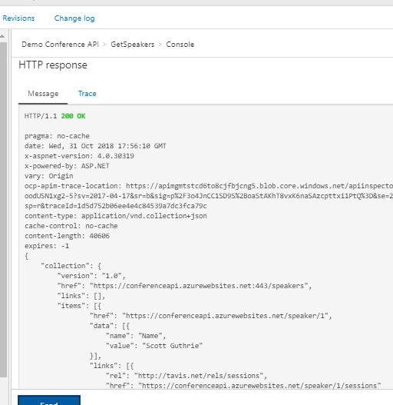
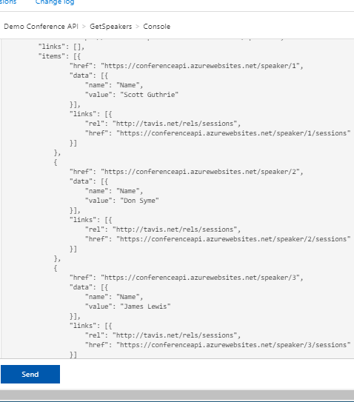

Slide 50
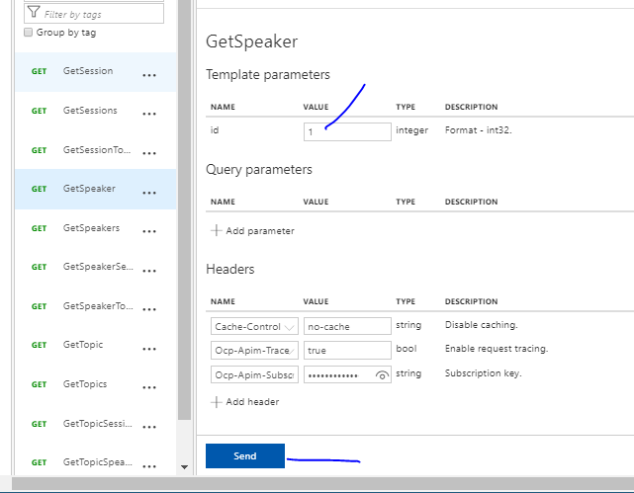

Slide 51
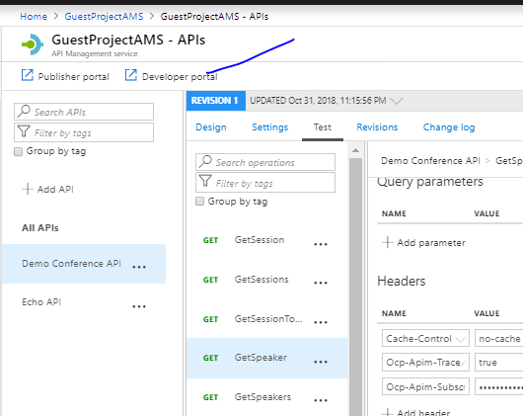

Slide 52
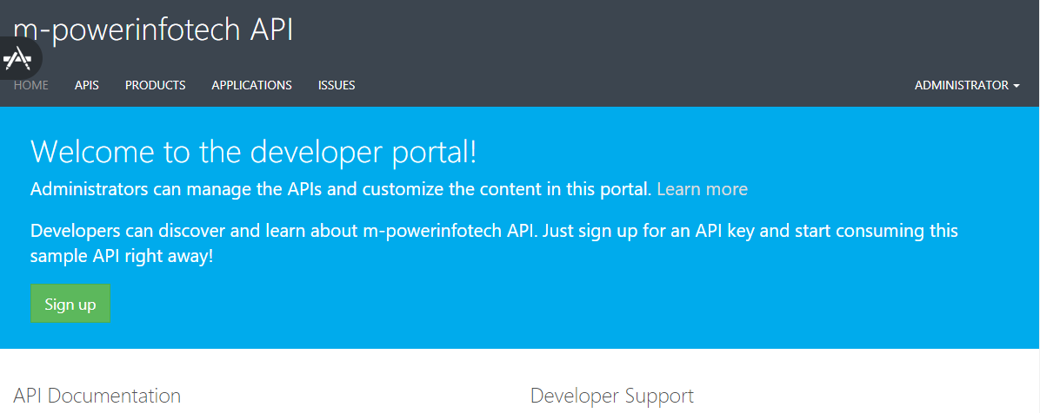

Slide 53
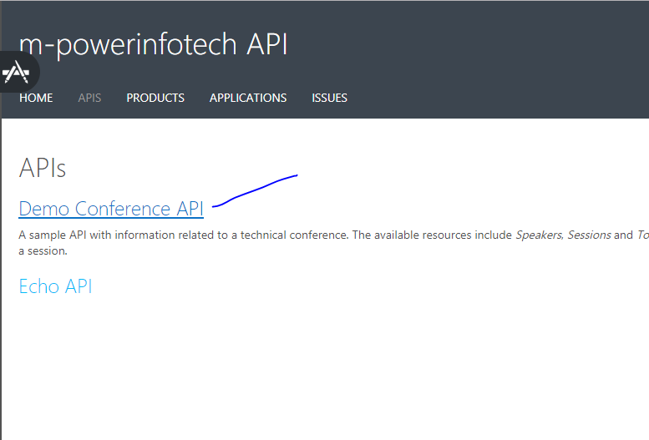

Slide 54
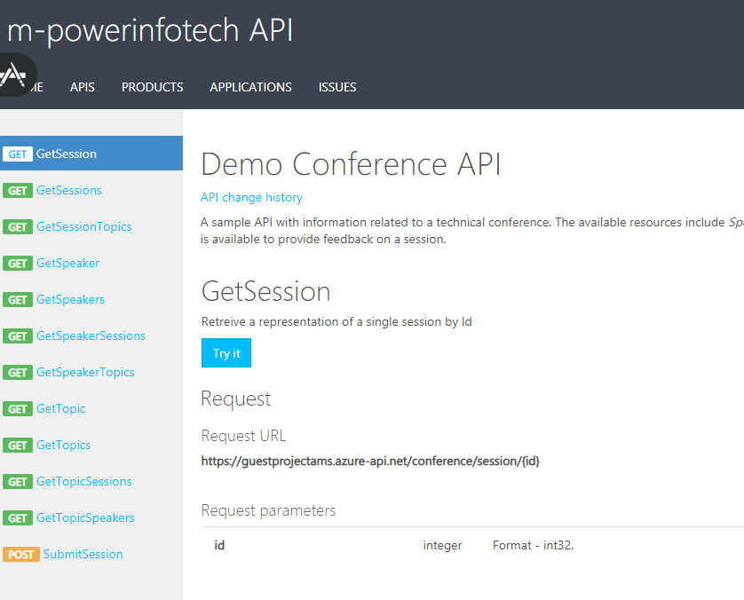

Slide 55
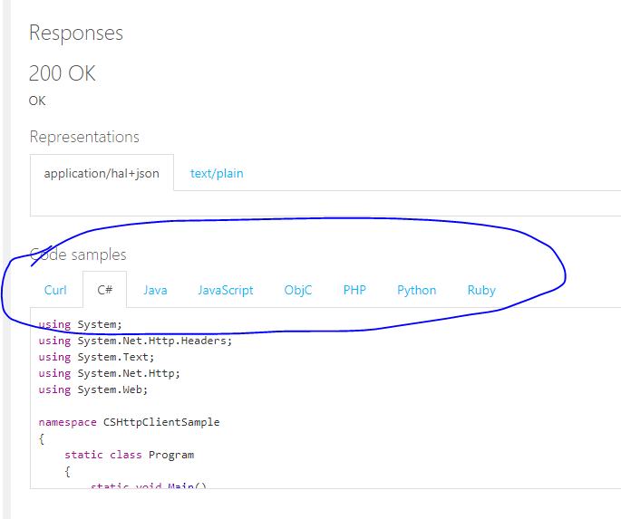
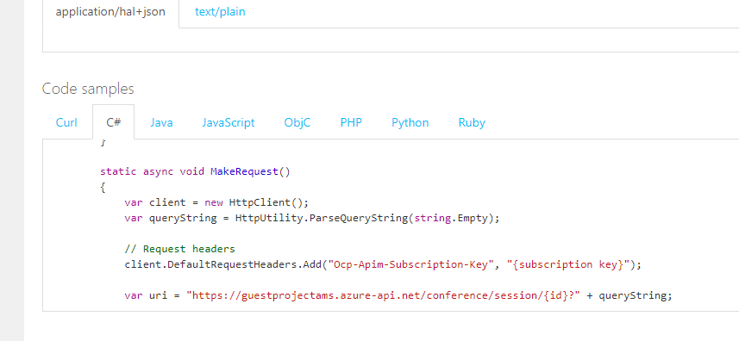

Slide 56
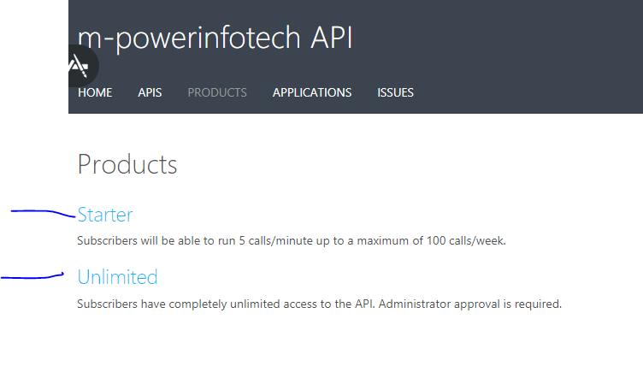

Slide 57
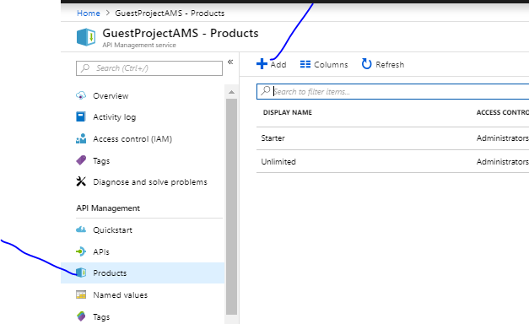

Slide 58
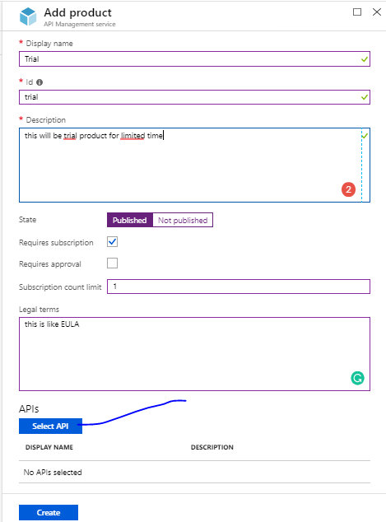

Slide 59
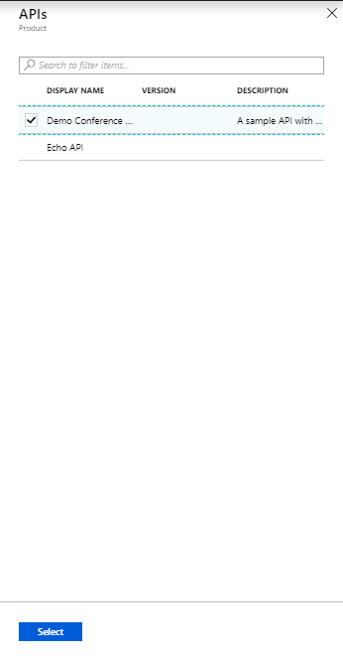

Slide 60
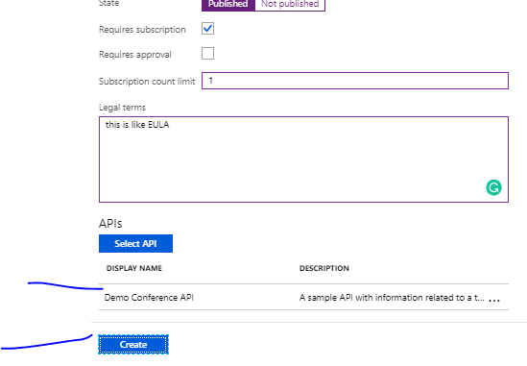

Slide 61
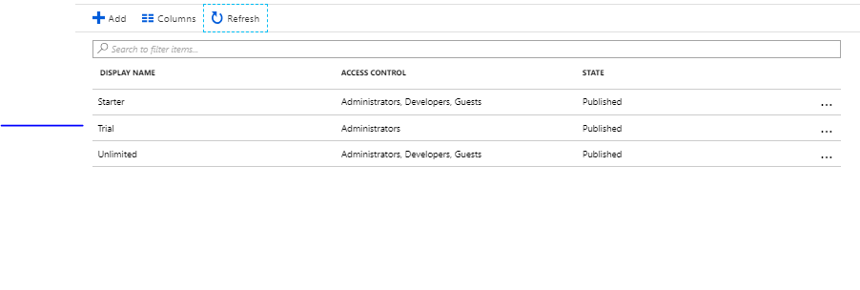

Slide 62
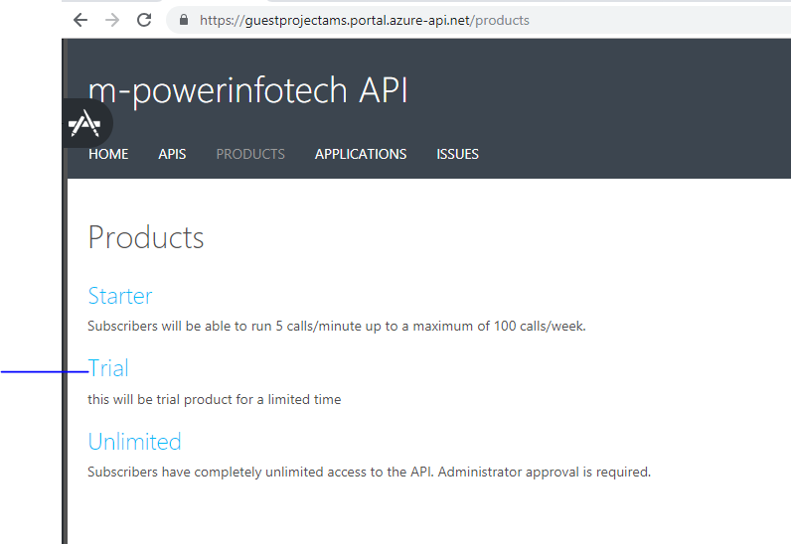

Slide 63
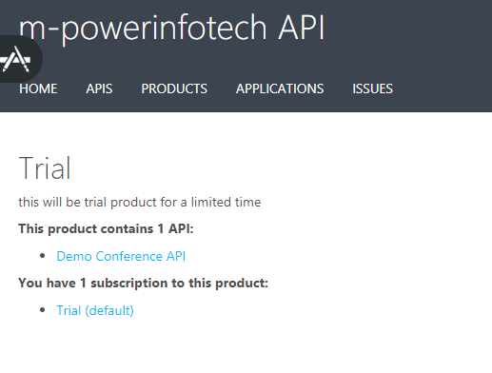

Slide 64
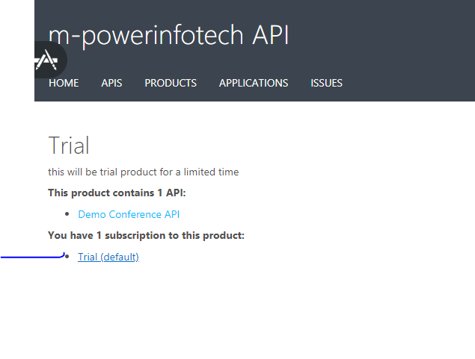

Slide 65


Slide 66


Slide 67


Slide 68


Slide 69

Click twice
And you will
Get 2 like this

Slide 70

Remove value tag and save

Slide 71


Slide 72


Slide 73
Protect an API by adding rate limit policy (throttling)
you may want to limit a number of calls the API is called so it is not overused by developers.
In this example, the limit is set to 3 calls per 15 seconds for each subscription Id. After 15 seconds, a developer can retry calling the API.

Slide 74


Slide 75


Slide 76


Slide 77

Send 3 times
quickly

Slide 78

At 4th time you will
Get this
Wait for some seconds
And again it will
Start showing

